Slide 1
Materials & Corrosion
Aerospace Manufacturing Core Study Guide
“AMCSG-103”
Introduction to Aerospace Manufacturing

Slide 2
Aircraft Materials

Slide 3
Primary Materials in Commercial Aircraft
Text & Stats from Google AI
Using newer Boeing 787 or Airbus A350 as a reference…
50% Composites (carbon fiber, epoxy, fiberglass, aramid fibers, …)
45% Metals (aluminum alloys, titanium, steel, ...)
5% Other (plastics, wood, copper wiring, ...)
Using traditional jetliners like 737 or 747…
75-80% Aluminum Alloys: (most common alloys are 2024 & 7075)
10-15% Steel
5-10% Titanium
< 1-3% Other
Notes:
Source:
List of Materials + Metrics: Google “what are the primary materials used in commercial jets today” >> AI tab … Added up 20% Aluminum + 15% titanium + 10% steel for metals

Slide 4
Material Properties
Text from Google AI
Materials are selected based on properties & performance
Strength: Stronger is better … four: tensile, shear, bearing, yield
Weight: Lighter is better
Cost: Lower cost is better
---------------------------------------------------------------------------
Durability: Longer life is better … corrosion is bad
Usability: Easier maintenance is better
Appearance: You know it when you see it … avoid ugly

Slide 5
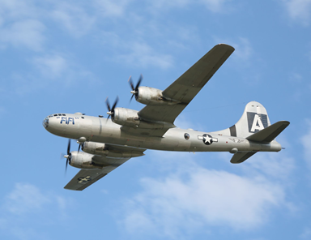
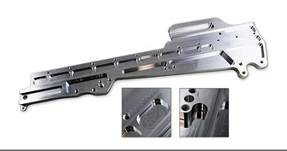
Properties of Aluminum Alloys
Text from Google AI
Aluminum alloys win when
Ease of Fabrication (Usability) and (Cost) are critical (up to 80% by weight in traditional aircraft)
Fatigue and Corrosion Resistance (Durability) is critical
Aluminum is used in:
Fuselage & Wing Skins for high strength, low weight, durability
Structural components for strength in wing ribs, stringers, etc.
Other Components like seat frames, cockpit/cabin furniture, etc.
(CC2) Wikimedia Commons
(Ad) Datron Milled Aluminum Part
Notes:
Dr. Google: “when is aluminum the best material to use on airplane”
Dr. Google: “Aluminum in aircraft manufacturing process”
Image Credits:
Google “B29” = CC2 - https://upload.wikimedia.org/wikipedia/commons/3/30/Boeing_B-29_Superfortress_%2819926000422%29.jpg
Google “Picture of Datron milled aluminum part” = (Adv) https://www.datron.com/resources/blog/4-examples-of-milling-aerospace-parts/

Slide 6
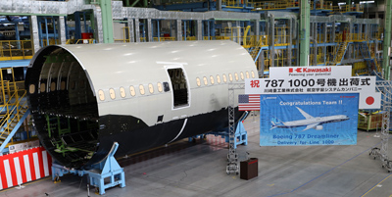
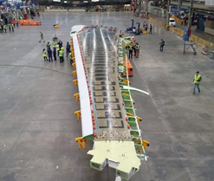
Properties of Composites
Text from Google AI
Composites win when:
Cost: Fuel Efficiency
Cost: Fewer Parts / Molded Shape
Durability: Fatigue and Corrosion Resistance
Composites are used in:
Fuselage & Wing Skins for high strength, low weight, durability
Structural components for strength in wing spars, stringers, etc.
Fairings for high impact resistance (aramid fibers)
(News) Kawaski.com, 2019
(News) Composites World
Notes:
Dr. Google: “when is composites the best material to use on airplane”
Dr. Google: “composites in aircraft manufacturing process”
Image Credits:
Google “Kawasaki 1000th 787 Fuselage section” = (News) - https://global.kawasaki.com/en/corp/newsroom/news/detail/?f=20191216_8615
Google “carbon fiber wing spar 777x” = (News) - https://theaircurrent.com/dispatches/beyond-the-carrier-deck-a-glimpse-at-the-777x-folding-wingtip/

Slide 7
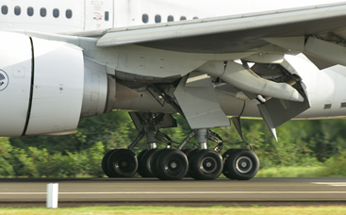
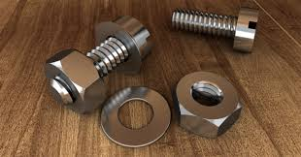
Properties of Titanium
Text from Google AI
Titanium wins when:
Strength: High Stress
Durability: Temperature Resistance
Titanium is used in:
Engine components for high heat
Landing Gear & Hydraulics for high fatigue resistance and strength
Structural airframes for strength in frames, splices, bolts, etc.
(CC3) Wikimedia Commons
(CC0) PxHere
Notes:
Dr. Google: “when is titanium the best material to use on airplane”
Dr. Google: “titanium alloy in aircraft manufacturing process”
Image Credits:
Google: “picture of titanium bolts” = (CC0) - https://pxhere.com/en/photo/1208085
Google: “777 landing gear wikimedia” = (CC3) - https://commons.wikimedia.org/wiki/File:Boeing-777-300_chassis.jpg

Slide 8
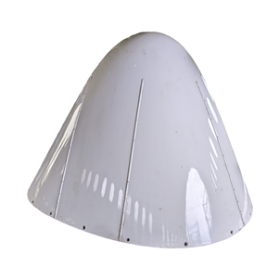
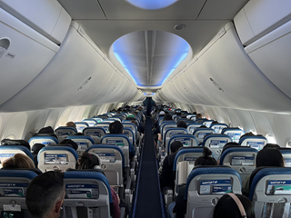
Properties of Fiberglass
Text from Google AI
Fiberglass wins when:
Usability: Transparency to radar waves
Usability: Ease of molding into complex aerodynamic shapes
Strength: Impact resistance against bird-strikes, etc.
Durability: Corrosion and fire resistance
Cost: Much less than Carbon or Aramid fibers
Fiberglass is used in:
Radomes and antennas for radar and signal transparency
Secondary structures like engine cowlings, wingtips, fairings, etc. for ease of molding and impact areas
Interior components like cabin walls, overhead bins, flooring, etc. for high durability and low cost
(Ad) PlaneReclaimers
(CC4) Wikimedia Commons
Notes:
Dr. Google: “when is fiberglass the best material to use on airplane”
Dr. Google: “fiberglass in aircraft manufacturing process”
Image Credits:
Google “Radome for sale”: (Ad) - https://planereclaimers.aero/product/boeing-aircraft-radome/
Google “inside 737 boeing.com”: (CC4) - https://commons.wikimedia.org/wiki/File:WestJet_Boeing_737_MAX_8_Interior.jpg

Slide 9
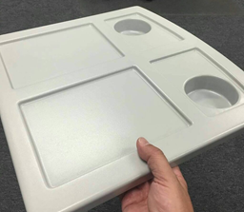
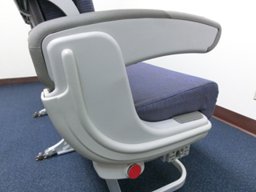

Properties of Plastics
Text from Google AI
Plastics win when
Weight & Cost: Very light & inexpensive
Durability: Maximum lifespan
Usability: Ease of manufacturing
Plastics are used in:
Luggage Bins & Panels where low weight, low cost and reasonable strength is critical
Tray tables, armrests, and seat backs for comfort are critical
(C) John Walton
(Ad) Dretloh Aircraft Supply
(Ad) Dretloh Aircraft Supply
Notes:
Dr. Google: “when is plastic the best material to use on airplane”
Dr. Google: “plastic in aircraft manufacturing process”
Image Credits:
Google “Picture of plastic overhead bins in 777” = (C) - https://runwaygirlnetwork.com/wp-content/uploads/2023/06/777X-header.-Image-John-Walton.jpg
Google “plastic seat tray” = (Ad) - https://dretloh.com/wp-content/uploads/2024/08/Traytable-e1488995091768-1024x893.jpg
Google “seat armrest” = (Ad) - https://dretloh.com/wp-content/uploads/2024/08/13430-31-URAL-Brice-7.jpg

Slide 10
Aircraft Corrosion

Slide 11
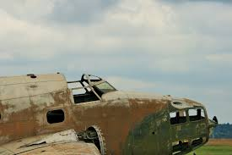
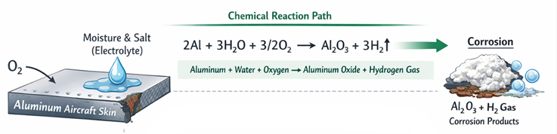
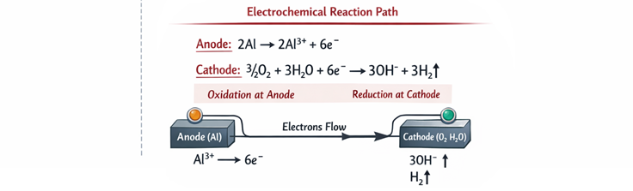
What is Corrosion?
“Corrosion turns metal to its natural state, a useless powder”
Example: Rust
How:
Chemical Reaction Path (Slow):
Metal + Water + Oxygen
= Corrosion ** Note: Thin, self-limiting layer on aluminum stops
Electrochemical Reaction Path (Fast):
Metal
+ Different Metal (far apart on galvanic corrosion chart)
+ Moisture / Oxygen / Acids / Bases / Salts / Oils
= Corrosion
(PD) PxHere
Corrosion in Aircraft
Chemical
ElectroChem
ChatGPT / Matt Pierce, 2026
Notes:
Image Credits:
Rusty carcass = (CC0) - https://pxhere.com/en/photo/1106074
Chat GPT diagram = “diagram electrochemical reaction leading to corrosion in aircraft. show both chemical reaction and electrochemical reaction paths”

Slide 12
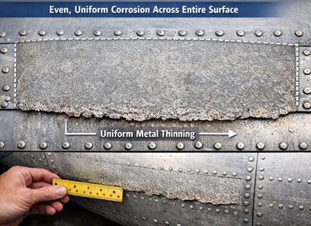
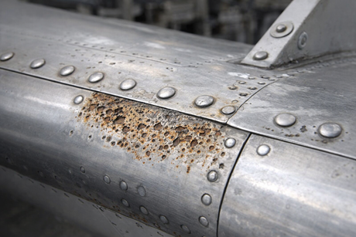
Types of Corrosion (1 of 4)
Text from Google AI
Uniform Corrosion (Etching / Surface)
Cause: Direct exposure oxygen + chemicals at surface after paint wears off
Appearance: General dulling
Most common; low risk of catastrophic failure
Pitting Corrosion
Cause: Damaged oxide film + damaged paint + non-metallic inclusions
Appearance: White/gray powder; localized holes or cavities after clean
Hard to detect, prevent, design against
High risk of catastrophic failure; especially magnesium & aluminum
ChatGPT / Matt Pierce, 2026
ChatGPT / Matt Pierce, 2026
Notes:
Excellent Source: https://www.ampp.org/technical-research/what-is-corrosion/forms-of-corrosion
Google AI: “aircraft corrosion types”
Image Credits:
Uniform Corrosion: ChatGPT “make a diagram showing uniform corrosion on a commercial aircraft part” + “Make better photo images”
Pitting Corrosion: ChatGPT “make a photo showing pitting corrosion on a commercial aircraft part”

Slide 13
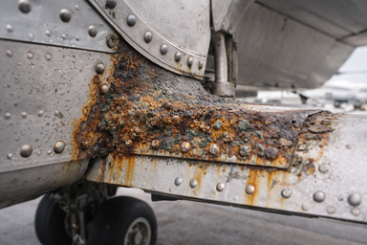
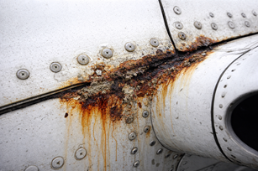
Types of Corrosion (2 of 4)
Text from Google AI
Galvanic Corrosion
Cause: Two dissimilar metals touch; anode side corrodes rapidly
Appearance: White, powdery or chalking deposit with pitting or flaking paint
In AI picture, Aluminum aircraft skin is fastened with Stainless-Steel rivets
Concentration Cell Corrosion (Crevice)
Cause: Tight gap traps moisture & pollutants; different concentrations / chemistry in crevice
Appearance: Surface discoloration; at nameplates, riveted heads, lapped joints, etc.
May not be visible until failure
In AI picture, water and debri accumulate in crevices
ChatGPT / Matt Pierce, 2026
Corrosion products
Water in crevice
ChatGPT / Matt Pierce, 2026
Notes:
Excellent Source: https://www.ampp.org/technical-research/what-is-corrosion/forms-of-corrosion
Google AI: “aircraft corrosion types”
Galvanic Corrosion: ChatGPT “make a photo showing galvanic corrosion on a commercial aircraft skin with stainless steel rivets”
Crevice Corrosion: ChatGPT “make a photo showing crevice corrosion on a commercial aircraft skin”

Slide 14
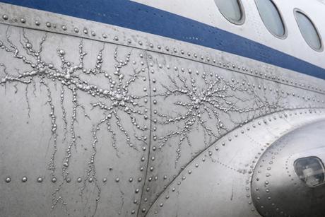
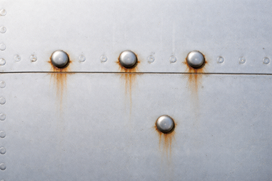
Types of Corrosion (3 of 4)
Text from Google AI
Filiform Corrosion
Cause: Humidity 78 to 90; surface slightly acidic; starts at breaks in protective coating
Appearance: Worm-like trace under painted or plated surfaces
Special form of “Crevice Corrosion”
Lacquers and quick-dry paints most susceptible
If left untreated, leads to intergranular corrosion
Fretting Corrosion
Cause: Debris between two tight vibrating surfaces = abrasive and corrosive
Appearance: Difficult to spot until late; pits and black debris
Located at bolted joints, splined shafts, bearings, and other clamped surfaces prone to tiny rubbing
ChatGPT / Matt Pierce, 2026
ChatGPT / Matt Pierce, 2026
Notes:
Excellent Source: https://www.ampp.org/technical-research/what-is-corrosion/forms-of-corrosion
Google AI: “aircraft corrosion types”
Filiform Corrosion: ChatGPT “make a photo showing filiform corrosion on a commercial aircraft skin” + “make the rust spider veins silver color and make them bubble out more from the skin”

Slide 15
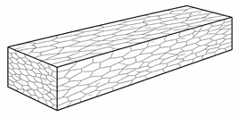
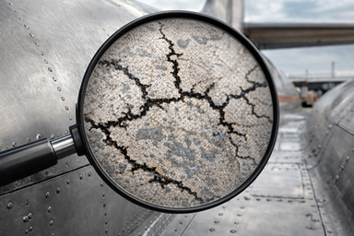
Types of Corrosion (4 of 4)
Text from Google AI
Intergranular Corrosion (Exfoliation)
Levelset: Microstructure of metals and alloys comprised of grains
Cause: Corrosion follows weak internal grain boundaries deep inside
Appearance: Difficult to spot until late exfoliation begins
Extremely dangerous / major hazard of high-strength aluminum alloys
Heat treating changes grain structure inside part
Requires ultrasonic or x-ray inspection to detect
Internal Grains
ChatGPT / Matt Pierce, 2026
ChatGPT / Matt Pierce, 2026
Notes:
Excellent Source: https://www.ampp.org/technical-research/what-is-corrosion/forms-of-corrosion
Google AI: “aircraft corrosion types”
Intergranular Corrosion: ChatGPT “make a photo showing “intergranular” corrosion following grains under a magnifying glass on a high-strength aluminum alloy part of a commercial aircraft”
Aluminum Bar with Intergranular grains: ChatGPT: “make a diagram showing a 2" x 4" x 4' aluminum bar. Add 20 randomly patterned internal grains on each of the three surfaces. Label them "short longitudinal", "short transverse", and "longitudinal transverse".” + “Convert this into a single clean presentation-ready image. Redraw it as an ASTM-style metallography diagram.” + “Remove the dimensions. Remove titles. Only keep the longer bar.” + “Remove titles “short longitudinal” and “short transverse and fix the bottom corner to tie in all three surfaces” + “make the longitudinal sides have grains that are 5 time longer. Leave the short face grains the same size.”
Fretting Corrosion: ChatGPT “make a photo showing fretting corrosion between commercial airliner aluminum skin and the aluminum rivets vibrating against it. Show rust stains below each rivet.” + “reduce the corrosion by half. reduce the number of fasteners by half”

Slide 16
Corrosion Prevention
Text from Google AI
Use of coatings to protect metals
Anodizing for Aluminum
Zinc- or Cadmium-plating for Steel
Special Treatments for Magnesium and Titanium
Magnesium is most anodic metal – highly susceptible to corrosion
Titanium is most cathodic metal – highly corrosion resistant, but contact will corrode other metals
Use of more corrosion-resistant materials
Improved adhesive bonding processes
Use of sealants in fastener holes and faying surfaces
Control of fluid spillage in galleys and lavatories
Notes:
Excellent Source: https://www.ampp.org/technical-research/what-is-corrosion/forms-of-corrosion
Google AI: “aircraft corrosion types”
Intergranular Corrosion: ChatGPT “make a photo showing “intergranular” corrosion following grains under a magnifying glass on a high-strength aluminum alloy part of a commercial aircraft”
Aluminum Bar with Intergranular grains: ChatGPT: “make a diagram showing a 2" x 4" x 4' aluminum bar. Add 20 randomly patterned internal grains on each of the three surfaces. Label them "short longitudinal", "short transverse", and "longitudinal transverse".” + “Convert this into a single clean presentation-ready image. Redraw it as an ASTM-style metallography diagram.” + “Remove the dimensions. Remove titles. Only keep the longer bar.” + “Remove titles “short longitudinal” and “short transverse and fix the bottom corner to tie in all three surfaces” + “make the longitudinal sides have grains that are 5 time longer. Leave the short face grains the same size.”
Fretting Corrosion: ChatGPT “make a photo showing fretting corrosion between commercial airliner aluminum skin and the aluminum rivets vibrating against it. Show rust stains below each rivet.” + “reduce the corrosion by half. reduce the number of fasteners by half”

Slide 17
Corrosion Prone Areas
Text from Google AI
Exhaust Trail Area behind engines (highly corrosive gases)
Battery Compartment Areas (highly corrosive fumes, needs venting)
Lavatories, Buffets, and Galleys (spilled water, food, and garbage)
Bilge Areas (designed to collect waste, fluids, dirt, loose fasteners, paint chips…)
Wheel Wells and Landing Gear (high exposure to elements: mud, water, salt, gravels, whatever comes up from runway)
Notes:
Excellent Source: https://www.ampp.org/technical-research/what-is-corrosion/forms-of-corrosion
Google AI: “aircraft corrosion types”
Intergranular Corrosion: ChatGPT “make a photo showing “intergranular” corrosion following grains under a magnifying glass on a high-strength aluminum alloy part of a commercial aircraft”
Aluminum Bar with Intergranular grains: ChatGPT: “make a diagram showing a 2" x 4" x 4' aluminum bar. Add 20 randomly patterned internal grains on each of the three surfaces. Label them "short longitudinal", "short transverse", and "longitudinal transverse".” + “Convert this into a single clean presentation-ready image. Redraw it as an ASTM-style metallography diagram.” + “Remove the dimensions. Remove titles. Only keep the longer bar.” + “Remove titles “short longitudinal” and “short transverse and fix the bottom corner to tie in all three surfaces” + “make the longitudinal sides have grains that are 5 time longer. Leave the short face grains the same size.”
Fretting Corrosion: ChatGPT “make a photo showing fretting corrosion between commercial airliner aluminum skin and the aluminum rivets vibrating against it. Show rust stains below each rivet.” + “reduce the corrosion by half. reduce the number of fasteners by half”

Slide 18
Q&A

Slide 19
Practice Q&A’s (Q1-Q8)
Q5: What are three secondary material properties that also factor into aircraft design?
A: Durability, usability, and appearance
Q6: What material is best for ease of fabrication (usability), cost, and fatigue/corrosion resistance (durability)?
A: Aluminum
Q7: Aluminum can be used in skins, structural components (ribs, stringers), seat frames, etc.?
A: True
Q8:What material is best for fuel efficiency, simplicity (fewer parts), and high fatigue and corrosion resistance (durability)?
A: Composites
Q1: What are currently (2026) the two most common materials used in aircraft?
A: Aluminum alloys and composites
Q2: What are the most common metals used in aircraft?
A: Aluminum, titanium and steel
Q3: What are the most common aluminum alloys used in aircraft?
A: 2024 and 7075
Q4: What are the three most important material properties in aircraft design?
A: Strength, weight, and cost

Slide 20
Practice Q&A’s (Q9-Q16)
Q13: What material is best for transparency to radar waves, impact resistance against bird strikes, is corrosion and fire resistant, and is the lower cost?
A: Fiberglass
Q14: What material is best for very lightweight, very inexpensive, very easy to manufacture, very long-lasting, but least strong ?
A: Plastic
Q15: Plastic can be used for structural elements (spars, strings, etc.) and skins?
A: False
Q16: Chemical corrosion can occur slowly with metal + water + oxygen.
A: True
Q9: Composites can be used in skins and structural components (spars, stringers, etc.)?
A: True
Q10: What material is best for high strength, high stress, and temperature resistance?
A: Titanium
Q11: Titanium can be used in engine parts, landing gear, hydraulics, and structural airframes for high strength splices and bolts?
A: True
Q12: Fiberglass is used in radomes, antennas, engine cowlings, and wingtips.
A: True

Slide 21
Practice Q&A’s (Q17-Q24)
Q21: What type of corrosion looks like cavities after cleaned, is hard to detect, prevent and design against, and is high risk?
A: Pitting corrosion
Q22: What type of corrosion involves two dissimilar metals touching, where anode side corrodes rapidly?
A: Galvanic corrosion
Q23: What type of corrosion occurs at tight gaps of the same overlapping material?
A: Concentration cell corrosion
Q24: What type of corrosion occurs at humidity 78 to 90 and looks like work-likes tunnels?
A: Filiform corrosion (aka crevice corrosion)
Q17: Chemical corrosion can occur with metal + acid
A: True
Q18: What is another name for electrochemical corrosion?
A: Galvanic corrosion
Q19: What is required to make galvanic corrosion?
A: Two different metals conducting electrical charge thru moisture, acid, base, salt, or oil
Q20: What type of corrosion is the most common, has a general dulling, and is low risk?
A: Uniform corrosion

Slide 22
Practice Q&A’s (Q25-Q32)
Q29: Using sealants at joints and penetrations protects metal from corrosion.
A: True
Q30: What exterior facing surfaces are prone to corrosion?
A: Wheel wells, landing gear, and exhaust trail (behind engines)...anywhere dirt, debris and hot chemicals accumulate
Q31: What interior facing surfaces are prone to corrosion?
A: Battery compartment, lavatories, buffets, galleys, and bilge areas...anywhere water can collect
Q32: What is the biggest threat to metal on an aircraft?
A: Corrosion
Q25: What type of corrosion occurs between two tight vibrating surfaces (abrasive & corrosive)?
A: Fretting corrosion
Q26: What type of corrosion occurs microscopically at the grains inside the allow (like wood grains), and is extremely dangerous?
A: Intergranular corrosion
Q27: Anodizing is a process to protect aluminum from corrosion.
A: True
Q28: Zinc- or Cadmium-plating is a process to protect steel from corrosion.
A: True

Slide 23
Practice Q&A’s (Q33-Q37)
Q33: What are plastics primarily used for?
A: Interior cabin
Q34: What material is lightest and strongest?
A: Composites (esp. carbon fiber)
Q35: What is the primary disadvantage to using aluminum components?
A: Labor cost to assemble and rivet or bolt it all together.
Q36: What type of metal is a combination of two or more pure metals into a single new stronger, better metal?
A: Alloy
Q37: What is a more important criteria than strength, weight, cost, durability, usability, and appearance?
A: Safety!!!

Slide 24
Thank You
Matt Pierce - mpierce710006@gmail.com - linkedin.com/in/mpiercead576/
https://github.com/DataResearchLabs/study_guide_intro_aerospace_mfg

